Slide 1
OOP
OOP Principles: Inheritance & Polymorphism
Based on Barnes and Kolling Chapter 8
Adapted by Rob Allen, A Bayley

Slide 2
Content
Inheritance
Polymorphism
Notes:
SDJ Lecture 9: Creating Reliable Programs
© Swinburne & © Pearson Education IncA Bayley
A Bayley

Slide 3

Learning Objectives
Students should be able to:
confidently use and understand the jargon of inheritance
explain what an inheritance hierarchy is and how it applies to Java
describe practical benefits of inheritance
implement inheritance relationships in code
use constructors appropriately in classes that extend other classes
(c) Barnes & Kolling
Notes:
SDJ Lecture 9: Creating Reliable Programs
© Swinburne & © Pearson Education IncA Bayley
A Bayley

Slide 4
Learning Objectives cont…
describe what sub-typing is, implement in code and describe the benefits of subtyping
describe the purpose of casting, why it is necessary and associated risks
describe the benefits provided by polymorphic behaviour
describe what a wrapper class, name some wrapper classes and describe the benefits of a wrapper class
explain what autoboxing/ unboxing is and demonstrate in code
© Swinburne
Notes:
SDJ Lecture 9: Creating Reliable Programs
© Swinburne & © Pearson Education IncA Bayley
A Bayley

Slide 5
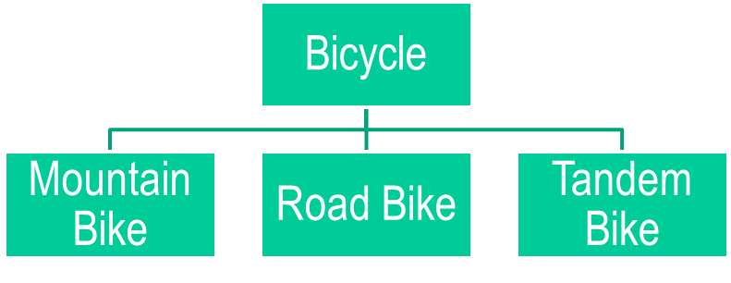
Inheritance in a nutshell…
Inheritance is a way to establish parent-child relationships between objects
Object-oriented programming allows classes to inherit commonly used state and behavior from other classes
Super Class
Sub Classes

Slide 6
The social network example
The network project implements a prototype of a news feed, where a list of messages should appear on screen when a user opens the network’s main page. (Source: Barnes & Kolling Chapter 8)
The news feed application:
  stores text posts and photo posts.
    MessagePost: multi-line text message.
    PhotoPost: photo and caption.
  Allows operations on the posts:
    e.g., add, search, display and remove.
(c) Barnes & Kolling

Slide 7
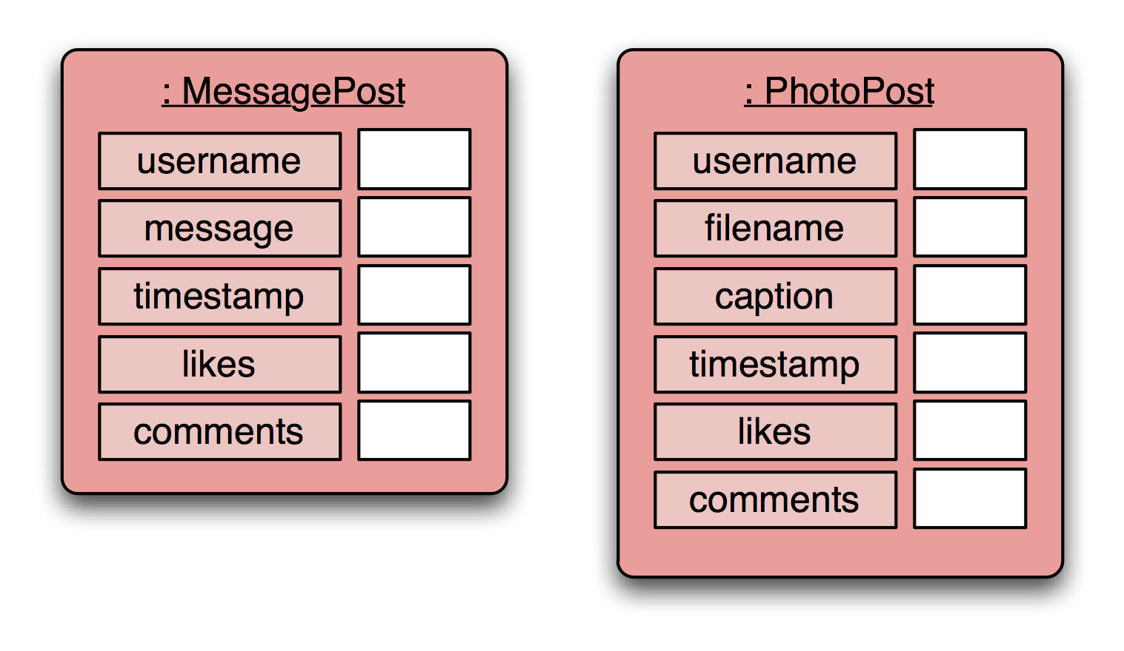
Newsfeed objects
(c) Barnes & Kolling

Slide 8
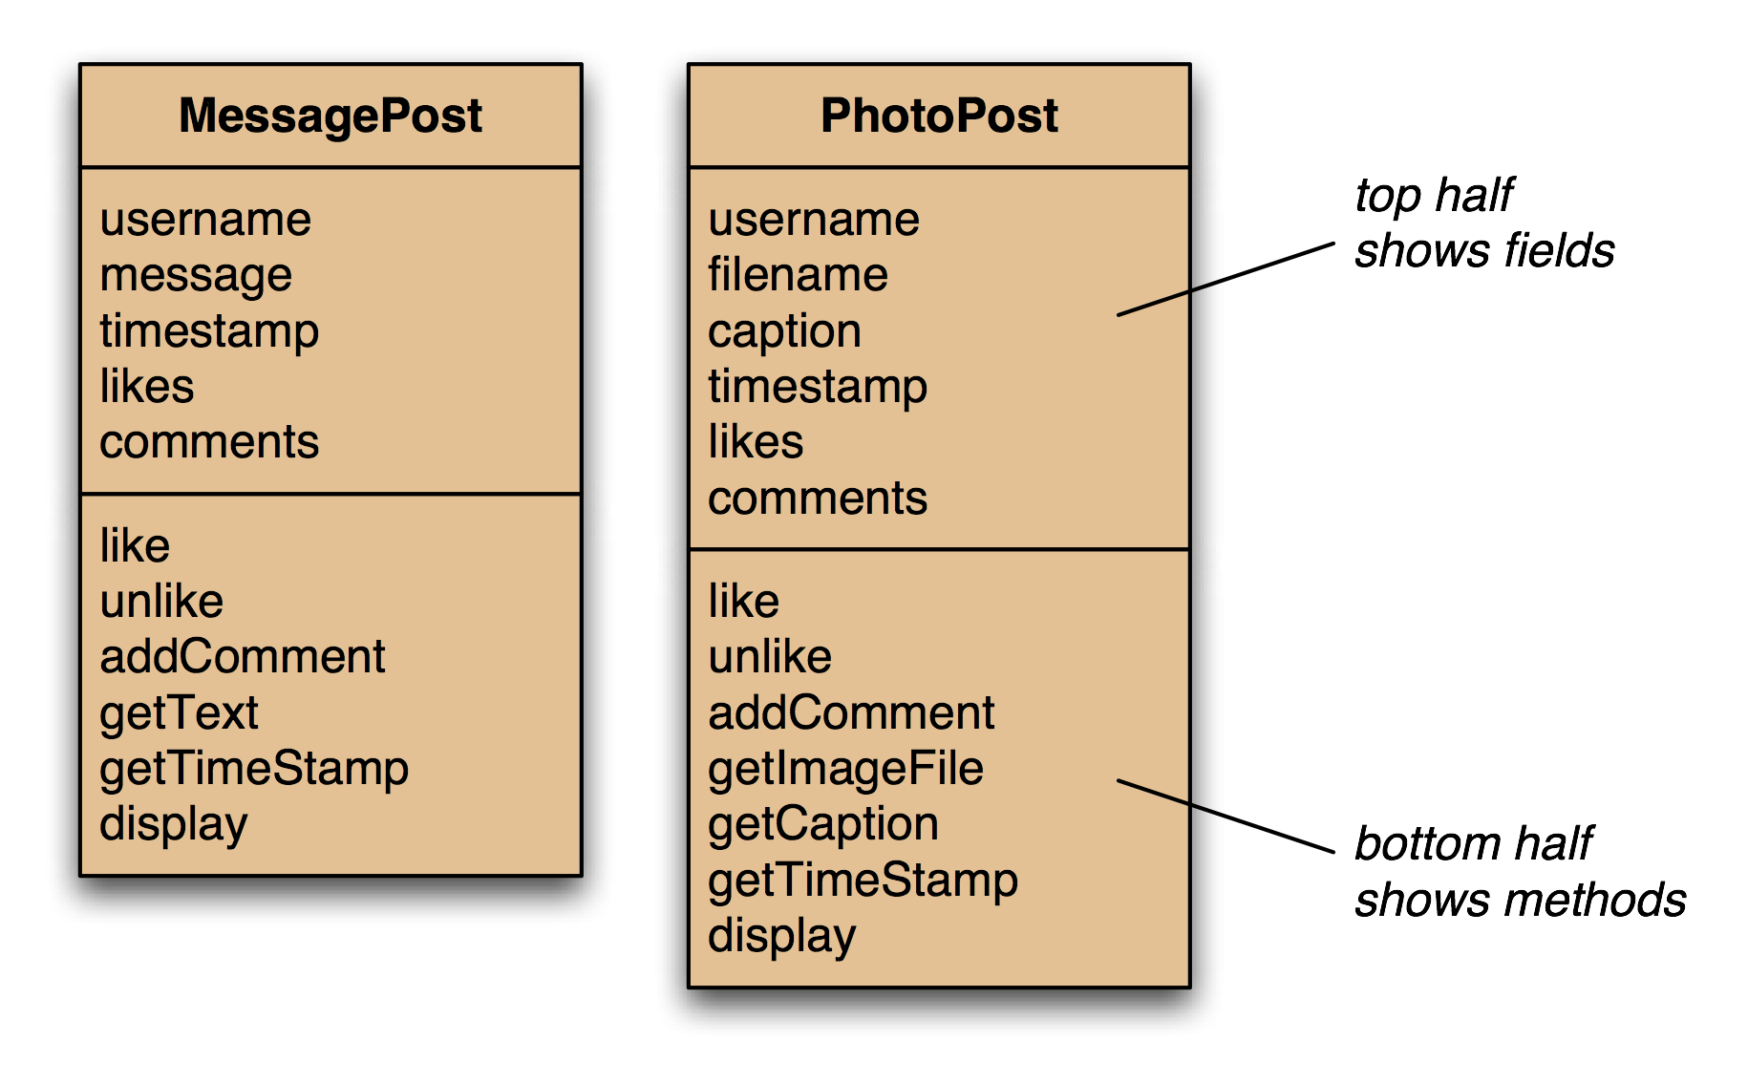
The two classes with fields and methods
(c) Barnes & Kolling
Notes:
Note:: this is not a UML class diagram

Slide 9
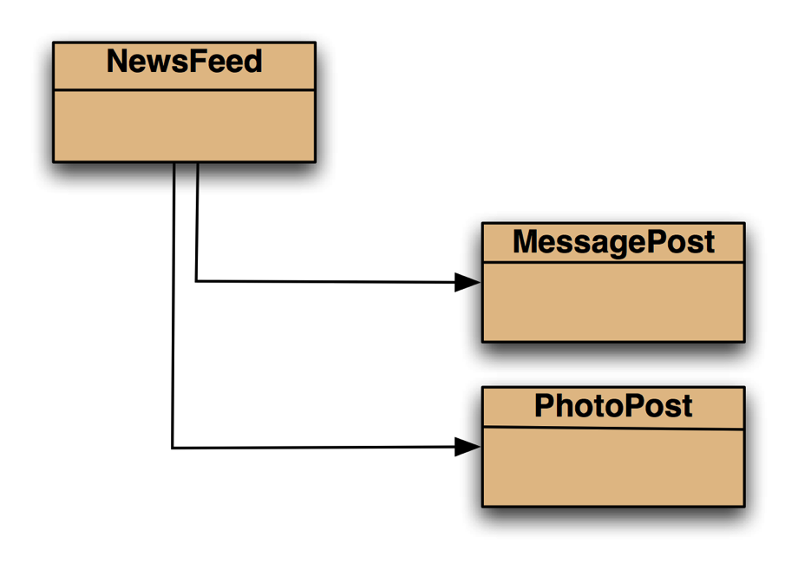
Simple structure
The NewsFeed class is ceated to hold the collection of MessagePost and PhotoPost objects
(c) Barnes & Kolling
Notes:
We then need another object: an object representing the complete news feed that can hold a collection of message posts and a collection of photo posts. For this, we shall create a class called NewsFeed.

Slide 10
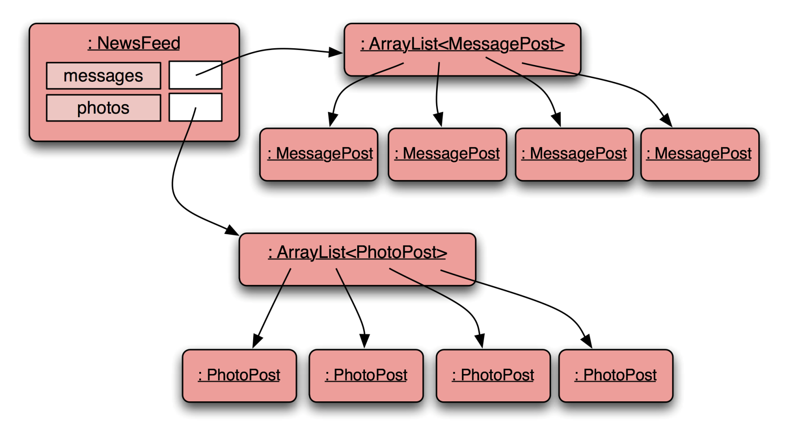
Object model
(c) Barnes & Kolling
Notes:
SDJ Lecture 9: Creating Reliable Programs
© Swinburne & © Pearson Education IncA Bayley
A Bayley

Slide 11
Message
Post
Code
public class MessagePost
{
private String username;
private String message;
private long timestamp;
private int likes;
private ArrayList<String> comments;
public MessagePost(String author, String text)
{
username = author;
message = text;
timestamp = System.currentTimeMillis();
likes = 0;
comments = new ArrayList<String>();
}
public void addComment(String text) ...
public void like() { likes++; }
public void display() ...
...
}
an outline
(c) Barnes & Kolling
Notes:
SDJ Lecture 9: Creating Reliable Programs
© Swinburne & © Pearson Education IncA Bayley
A Bayley
To make it very simple a comment is stored in a String object, where as in an actual system comments will be a separate class holding many other details.
Timestamp is stored in a long variable so that we can easily get and store the system time from the Java system, as a long value in milliseconds.

Slide 12
Photo
Post
Code
public class PhotoPost
{
private String username;
private String filename;
private String caption;
private long timestamp;
private int likes;
private ArrayList<String> comments;
public PhotoPost(String author,
String filename, String caption)
{
username = author;
this.filename = filename;
this.caption = caption;
timestamp = System.currentTimeMillis();
likes = 0;
comments = new ArrayList<String>();
}
public void addComment(String text) ...
public void like() ...
public void display() ...
...
}
An outline
(c) Barnes & Kolling
Notes:
SDJ Lecture 9: Creating Reliable Programs
© Swinburne & © Pearson Education IncA Bayley
A Bayley

Slide 13
public class NewsFeed
{
private ArrayList<MessagePost> messages;
private ArrayList<PhotoPost> photos;
...
public void addMessagePost(MessagePost m)
{
....
}
public void addPhotoPost(PhotoPost p)
{
....
}
public void show()
{
for(MessagePost message : messages) {
message.display();
System.out.println(); // empty line between posts
}
for(PhotoPost photo : photos) {
photo.display();
System.out.println(); // empty line between posts
}
}
}
NewsFeed Class Code
This is just to demonstrate how inheritance works, ideally printing must be done in the UI
(c) Barnes & Kolling

Slide 14
Critique ( What’s wrong with the classes: MessagePost, PhotoPost and NewsFeed???)
Code duplication in MessagePost and PhotoPost classes
  The two classes are very similar (large part are identical)
  Makes maintenance difficult/more work
  Introduces danger of bugs through incorrect maintenance
Code duplication also in NewsFeed class
  Everything is duplicated: once for MessagePosts and once for PhotoPosts
Notes:
SDJ Lecture 11 : Inheritance 1
© Swinburne & © Pearson Edcucation, Inc 2009
we note a lot of code duplication.
this is one problem with this solution (there are others)

Slide 15
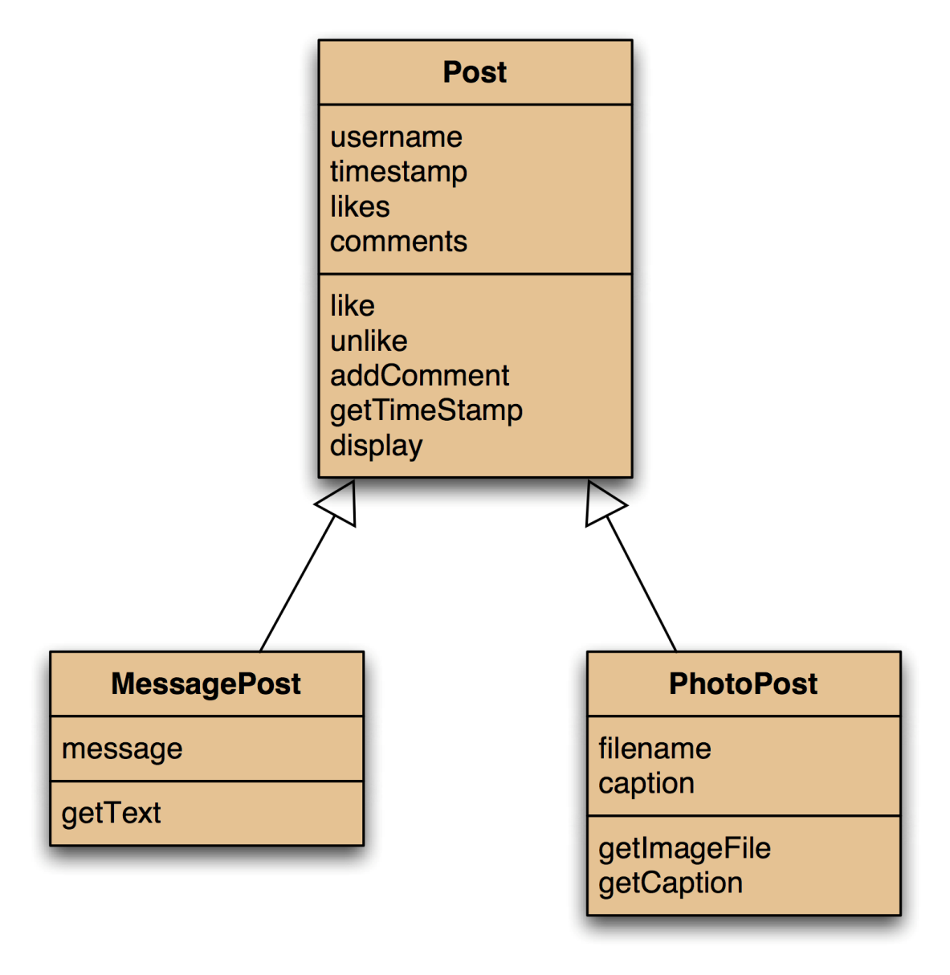
Using inheritance to overcome the problem
Superclass
Note notation: MessagePost inherits from Post.
PhotoPost is a type of Post (subclass of Post)
MessagePost is a type of Post (subclass of Post)
Is–a Relationship: Subclass is a specialization of Super class
(c) Barnes & Kolling

Slide 16
Using inheritance
The common parts, the parent class
define one superclass : Post
define subclasses for MessagePost and PhotoPost
the superclass defines common attributes
the subclasses inherit the superclass attributes
the subclasses define it’s own unique attributes
The new or changed bits, the children
Effectively not the private ones – they exist but are not accessible.
(c) Barnes & Kolling
Notes:
SDJ Lecture 11 : Inheritance 1
© Swinburne & © Pearson Edcucation, Inc 2009

Slide 17
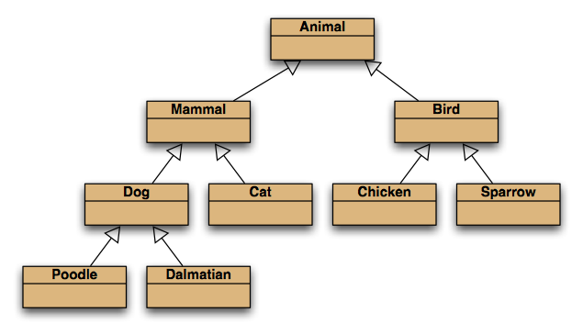
Inheritance hierarchies
A favourite example in many introductory books
(c) Barnes & Kolling
Notes:
SDJ Lecture 11 : Inheritance 1
© Swinburne & © Pearson Edcucation, Inc 2009
inheritance hierarchies are nothing unusual. we see them all the time.
(a masters student is a student is a person...)

Slide 18
Implementing inheritance in Java
Parent / super class
public class Post
{
...
}
no change here
change here
One super class, many sub classes
public class PhotoPost extends Post
{
...
}
public class MessagePost extends Post
{
...
}
extends keyword is used in Java to define the inheritance relationship
(c) Barnes & Kolling
Notes:
SDJ Lecture 11 : Inheritance 1
© Swinburne & © Pearson Edcucation, Inc 2009
syntax for inheritance: extends keyword

Slide 19
Superclass code: Post class
public class Post
{
private String username;
private long timestamp;
private int likes;
private ArrayList<String> comments;
/**
* Initialise the fields of the post.
*/
public Post(String author)
{
username = author;
timestamp = System.currentTimeMillis();
likes = 0;
comments = new ArrayList<String>();
}
// methods omitted
}
The attributes common to all children
This super class has only one constructor
(c) Barnes & Kolling

Slide 20
Subclass code: MessagePost, PhotoPost
public class MessagePost extends Post
{
private String message;
...
}
Unique attribute
public class PhotoPost extends Post
{
private String filename;
private String caption;
...
}
Unique attributes
(c) Barnes & Kolling

Slide 21
Inheritance and initialization
public class MessagePost extends Post
{
private String message;
/**
* Constructor for objects of class MessagePost
*/
public MessagePost (String author, String text)
{
super(author);
message = text;
}
public String getText()
{
return message;
}
public void setText(String text)
{
message = text;
}
}
A call from the subclass constructor to the super class constructor
Methods like(), unLike(),
addComment(), getTimeStamp(),
display() inherited
The call to super() must
be on the first line of subclass constructor
(c) Barnes & Kolling
Notes:
When we create a MessagePost object we need to pass author and text attributes. However author belongs to the superclass – Post, and text is unique to MessagePost class. To initialize these attributes properly we need to pass author to the superclass by calling the superclass constructor and initialize text within the MesagePost class constructor.
In Java, a subclass constructor must always call the superclass constructor as its first statement.
If you do not write a call to a superclass constructor, the Java compiler will insert a superclass call automatically, to ensure that the superclass fields get properly initialized.

Slide 22
Superclass constructor call
Subclass constructors must always contain a 'super' call.
If none is written, the compiler inserts one (without parameters - default constructor)
  works only, if the superclass has such a constructor without parameters
A 'super' call must be the first statement in the subclass constructor.
Notes:
SDJ Lecture 11 : Inheritance 1
© Swinburne & © Pearson Edcucation, Inc 2009

Slide 23
Inheritance and initialization
public class PhotoPost extends Post
{
private String filename;
private String caption;
public PhotoPost(String author, String fname, String capt)
{
super(author);
filename = fname;
caption = capt;
}
public String getImageFile()
{
return filename;
}
public String getCaption()
{
return caption;
}
//Setters need to be included
}
Methods such as like(), unLike(),
addComment(), getTimeStamp(),
display() inherited
(c) Barnes & Kolling

Slide 24
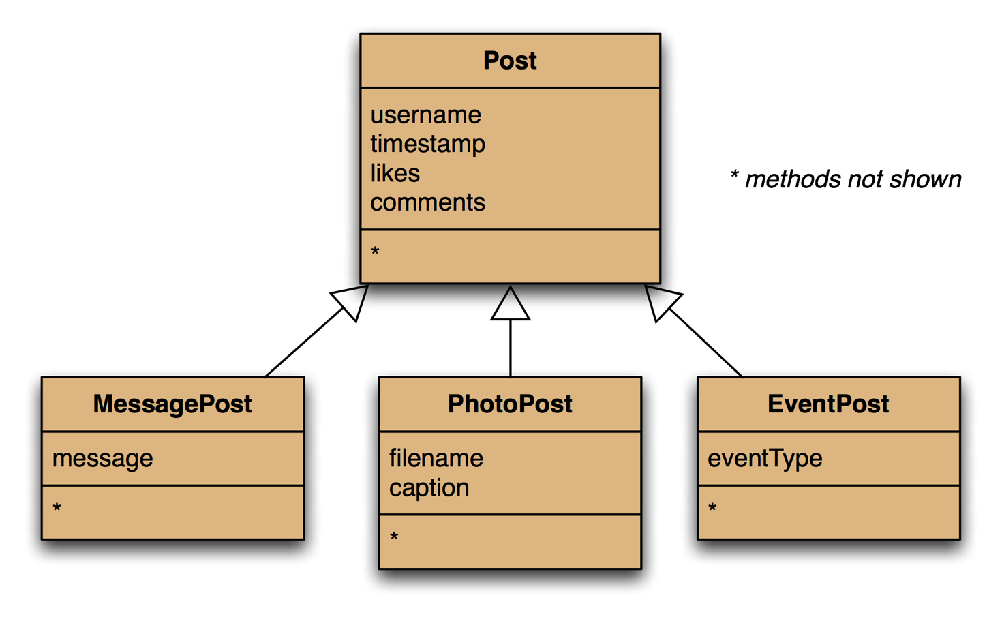
Adding more post types
Inheritance helps us to reuse existing work
eg "Sam has joined the 'BlueJ fans' group“,
“Jhon changed his profile pic”
(c) Barnes & Kolling

Slide 25
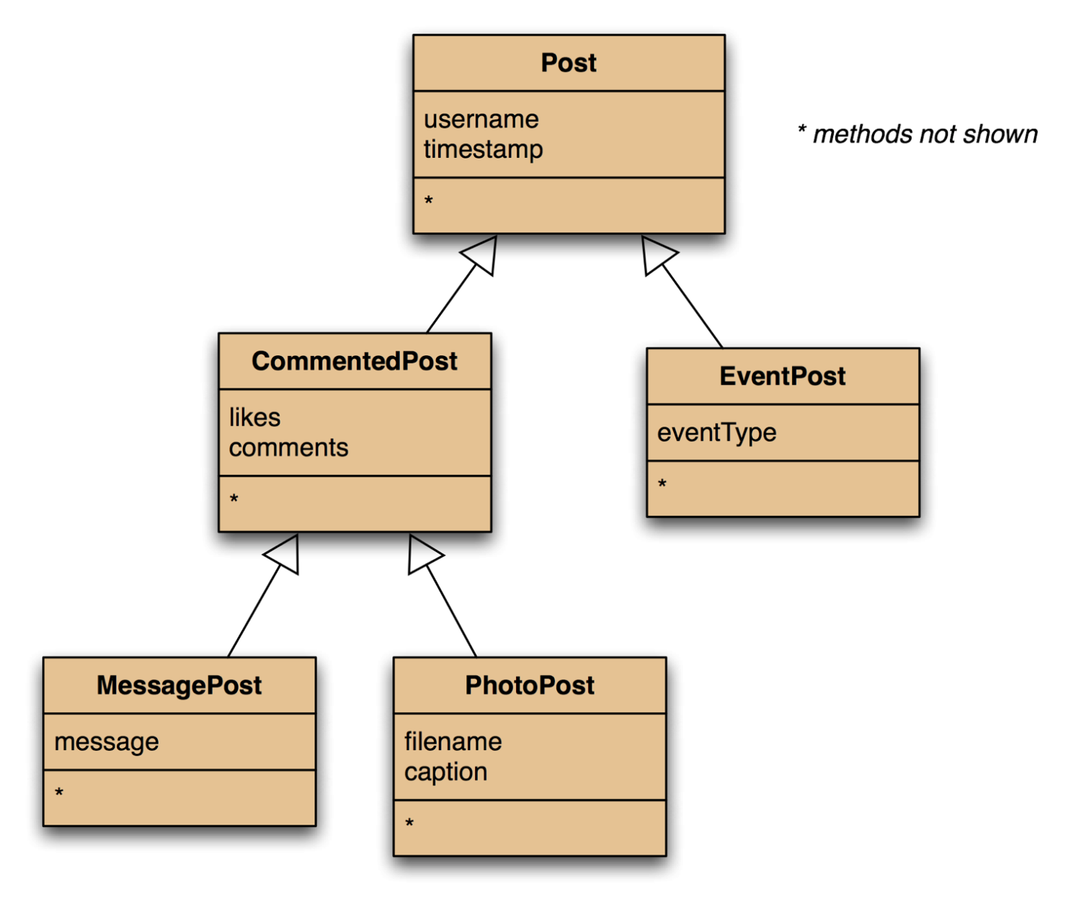
What if EventPost doesn’t need likes or comments?
Deeper Hierarchy
We can refactor the hierarchy to introduce a new superclass that holds all comments & likes and remove them from Post super class
(c) Barnes & Kolling

Slide 26
Review (so far)
What are the advantages of inheritance?
Avoiding code duplication
Code reuse
Easier maintenance
Extendibility
A better model of the real world
Notes:
SDJ Lecture 11 : Inheritance 1
© Swinburne & © Pearson Edcucation, Inc 2009

Slide 27
Take a deep breath, there is more…

Slide 28
New NewsFeed class source code
public class NewsFeed
{
private ArrayList<Post> posts;
/**
* Construct an empty news feed.
*/
public NewsFeed()
{
posts = new ArrayList<Post>();
}
/**
* Add a post to the feed.
*/
public void addPost(Post thePost)
{
posts.add(thePost);
}
...
}
Only a single collection now
avoids code duplication in client!
We can add instances of any of the subclasses
(c) Barnes & Kolling
Notes:
SDJ Lecture 11 : Inheritance 1
© Swinburne & © Pearson Edcucation, Inc 2009
note: code duplication in class NewsFeed removed as well!
only on field, one ArrayList creation, one add method

Slide 29
New NewsFeed class source code cont…
/**
* Show the news feed. Currently: print the
* news feed details to the terminal.
* (Later: display in a web browser.)
*/
public void show()
{
for(Post post : posts) {
post.display();
System.out.println(); // Empty line ...
}
}
Don't care exactly which subclass
This is just to demonstrate how inheritance works, ideally printing must be done in the UI
(c) Barnes & Kolling
Notes:
SDJ Lecture 11 : Inheritance 1
© Swinburne & © Pearson Edcucation, Inc 2009

Slide 30
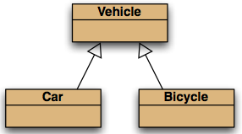
Substitution
Classes define types
Subclasses define subtypes
  E.g. MessagePost is a subtype of Post
Substitution - A variable can hold objects of its declared type or of any subtype of its declared type.
However Java does not allow to substitute a superclass object where a sub class object is expected.
Vehicle v1 = new Vehicle();
Vehicle v2 = new Car();
Vehicle v3 = new Bicycle();
√ legal
Car c1 = new Vehicle();
Car c2 = new Bicycle();
× illegal
(c) Barnes & Kolling
Notes:
Because a car is a vehicle, it is perfectly legal to store a car in a variable that is intended for vehicles.
However Java does not allow the other way round because, a Vehicle cannot always be a Car, so you cannot store a Vehicle object in a variable that is intended for a Car.

Slide 31
Substitution: Newsfeed example,
Adding posts ..
NewsFeed feed = ...
PhotoPost myPhoto = new PhotoPost(...);
feed.addPost(myPhoto);
MessagePost myNews = new MessagePost(...);
feed.addPost(myNews);
...
feed.show();
Substitution
(legal)
If we create a PhotoPost object we can use it in three different situations:
  In code where we need PhotoPosts
  In code where we need Posts
  In code where we need Objects
**We cannot use a Post object where we need a MessagePost or where we need a PhotoPost.
(c) Barnes & Kolling

Slide 32
Polymorphism
Polymorphism refer to the ability of a variable, method, or object to take on multiple forms.
The term ‘Polymorphic’ – many shapes
  A polymorphic variable may hold objects of many types (meaning objects of its own type and subtypes)
Reference variables in Java are polymorphic.
(They can refer to objects of more than one type.)
  They can refer to objects of the declared type, or of subtypes of the declared type.
© Barnes & Kolling © Swinburne

Slide 33
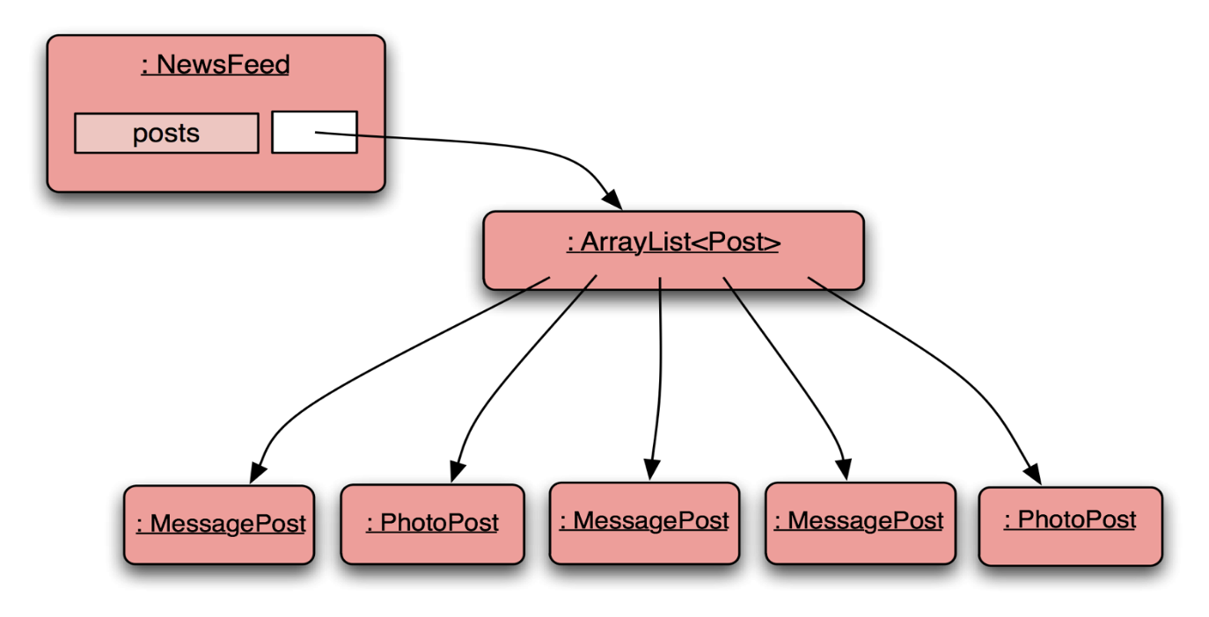
Polymorphism: NewsFeed example
public class NewsFeed
{
……
……
public void show()
    {
    for(Post post : posts)
    {
    post.display();
    ...
    }
    }
}
The actual list of posts will contain a mix of MessagePost and PhotoPost objects.
The post variable is polymorphic, thus able to store objects of MessagePost or PhotoPost
(c) Barnes & Kolling

Slide 34
Casting
We can assign subtype to supertype…
But we cannot assign supertype to subtype directly
Casting fixes this:
Vehicle v;
Car c = new Car();
v = c;
√
Known as Upcasting
c = v;
X compile-time error!
Known as Downcasting
c = (Car)v;
√
(c) Barnes & Kolling

Slide 35
Casting
  Before down casting we can check if the object is really of that type.
    Downcast is only sensible if the object is an instance of a subclass, hence type checking and type cast are required
  A runtime check is made to ensure the object really is of that type
    ClassCastException is thrown if it isn't
if (v instanceof Car)
c = (Car)v;
If in doubt we can check
(c) Barnes & Kolling
Notes:
Casting should be avoided wherever possible, because it can lead to runtime errors, and that is clearly something we do not want.
In a well structured OO program casting is rarely used.

Slide 36
Exercise:
Consider:
  Pen p;
  BallpointPen b = new BallpointPen();
  FountainPen f;
  ...
  p = b; ??
  f = (FountainPen)b; ??
  f = (FountainPen)p; ??
Pen
BallpointPen
FountainPen
√
X compile error
X runtime error
(c) Barnes & Kolling
Notes:
The last two assignments will both fail.
The attempt to assign b to f (even with the cast) will be a compile-time error. The compiler notices that BallpointPen and FountainPen do not form a subtype/supertype relationship.
The attempt to assign p to f (with the cast) will be accepted at compile time but will fail at runtime. Pen is a superclass of FountainPen, and thus p can potentially hold a FountainPen object. At runtime, however, it turns out that the object in p is not a FountainPen but a BallpointPen, and the program will terminate prematurely

Slide 37
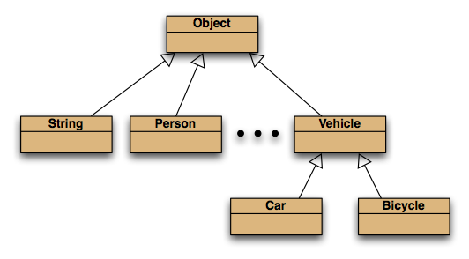
The ultimate superclass
All classes inherit from Object
Object is a class in Java Standard Library that serves as a Superclass for all classes we create!
(c) Barnes & Kolling
Notes:
Advantages of having the object superclass:
We can declare polymorphic variables of type Object to hold any object.
The Object class can define some methods that are then automatically available for every existing object (e.g. toString(), equals() etc.)

Slide 38
Collections of Object
ArrayList is equivalent to ArrayList<Object>
so
  public void add(Object element)
  public Object get(int index)
More explicit typecasts will be needed
and "unchecked or unsafe operation" warnings from javac
Where possible choose a superclass that is more suitable than Object
(c) Barnes & Kolling

Slide 39
Wrapper classes
Primitive types such as int, float, boolean, char etc. are not objects and does not inherit from Object class
  Thus, we cannot use them in a collection
  ArrayList<int> X
But what if we want to have a list of int values/ char values???
  Solution: Wrapper classes
Wrappers exist so primitive values can be placed in collections
Primitive type | Wrapper class
int | Integer
float | Float
char | Char
…. | …..
Wrapper classes exist for all primitive types.
They also are a place to keep static methods like Integer.parseInt().
(c) Barnes & Kolling

Slide 40
Using wrapper classes (explicitly)
Wrap the value
int i = 18;
Integer iwrap = new Integer(i);
Now we can easily store iwrap object in an ArrayList.
Unwrap the value
int value = iwrap.intValue();
(c) Barnes & Kolling

Slide 41
Autoboxing and unboxing
The compiler automatically wrapping a primitive is autoboxing
The compiler automatically unwrapping it is unboxing
private ArrayList<Integer> markList;
…
public void storeMark(int mark)
{
markList.add(mark);
}
autoboxing
int firstMark = markList.remove(0);
unboxing
The compiler automatically generates code. This is hidden (and inefficient).
Do not use autoboxing accidentally,
eg by using type Boolean instead of boolean.
(c) Barnes & Kolling

Slide 42
Summary
Inheritance allows the definition of classes as extensions of other classes.
Inheritance
  avoids code duplication
  allows code reuse
  simplifies the code
  simplifies maintenance and extending
Polymorphism refers to the ability to take many forms.
Variables can hold (refer to) many subtype objects (polymorphic variables).
Subtypes can be used wherever Supertype objects are expected (substitution) but not vice versa.
  But if really needed casting is done to store super type object in a subtype
(c) Barnes & Kolling

Slide 43
Reading
Reading:
  Barnes & Kolling Chapter 8
Exercises
  See lab work.
(c) Barnes & Kolling

Slide 44
OOP
OOP Principles: More on Inheritance & Polymorphism
Based on Barnes and Kolling Chapter 9

Slide 45
Content
Method Overriding
super.method
Dynamic and static binding
Protected visibility
equals() & toString()
Method overloading
Notes:
SDJ Lecture 9: Creating Reliable Programs
© Swinburne & © Pearson Education IncA Bayley
A Bayley

Slide 46
Learning Objectives
Students should be able to
override methods of a super-class in a sub-class
explain why it is useful to override methods
clearly describe how public, private and protected should be used in the context of inheritance.
describe what means for a class to inherit from the Object class
use and implement appropriate toString() methods
explain the distinction between a dynamic and static binding
be able to code equals()
Be able to understand method overloading
(c) Barnes & Kolling
Notes:
SDJ Lecture 9: Creating Reliable Programs
© Swinburne & © Pearson Education IncA Bayley
A Bayley

Slide 47
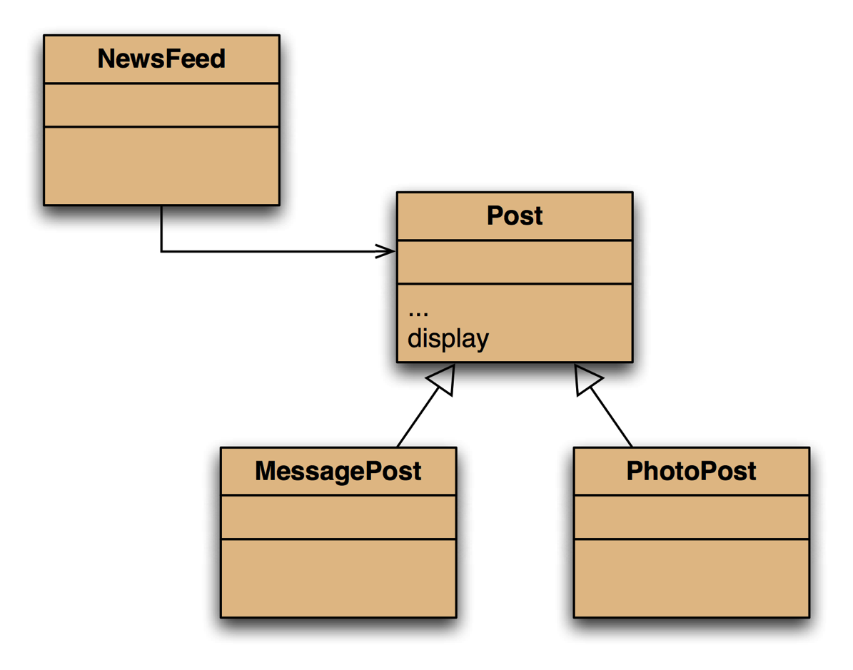
NewsFeed Example…
import java.util.ArrayList;
public class NewsFeed
{
  private ArrayList<Post> posts;
  public NewsFeed()
  {
  posts = new ArrayList<Post>();
  }
  public void addPost(Post post)
  {
  posts.add(post);
  }
  public void show()
  {
    for(Post post : posts) {
    post.display();
    System.out.println();
  }
  }
}
Inheritance hierarchy
(c) Barnes & Kolling

Slide 48
Inadequate display
What we want
What we get from post.display()
Leonardo da Vinci
Had a great idea this morning.
But now I forgot what it was. Something to do with flying ...
40 seconds ago - 2 people like this.
No comments.
Alexander Graham Bell
[experiment.jpg]
I think I might call this thing 'telephone'.
12 minutes ago - 4 people like this.
No comments.
Leonardo da Vinci
40 seconds ago - 2 people like this.
No comments.
Alexander Graham Bell
12 minutes ago - 4 people like this.
No comments.
(c) Barnes & Kolling

Slide 49
The problem
The display() method in Post class only prints the common fields.
  Only fields declared in Post are available for display()
Inheritance is a one-way street:
  A subclass inherits the superclass fields.
  The superclass knows nothing about its subclass’s fields.
(c) Barnes & Kolling

Slide 50
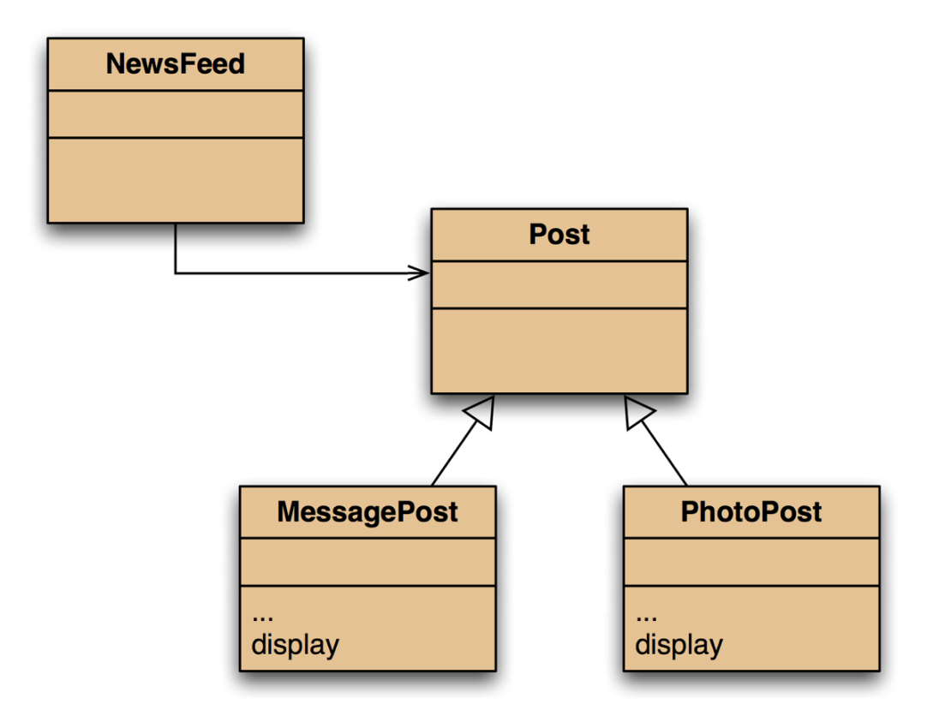
Attempted solution
Place display where it has access to the information it needs.
Each subclass can have its own version of display()
But subclass display() methods will not have access to superclass fields because Post’s fields are private
  We could change their visibility
  or add accessors but…
NewsFeed cannot find a display method in Post, ie
post.display();
won’t compile
(c) Barnes & Kolling

Slide 51

Solution – Method Overriding
display method in both super- and sub classes.
Method overriding - a sub class implementing a method that is already provided by it’s superclass

Slide 52
Method Overriding, a better solution
Superclass and subclass define methods with the same signature.
  public void display()
Each method has access to the fields of its class.
public class NewsFeed
{
……
……
  public void show()
  {
    for(Post post : posts) {
    post.display();
    System.out.println();
  }
  }
}
The relevant Subclass method is called at runtime - it overrides the superclass version.
What becomes of the superclass version?
Still available to be used
Not used unless called
(c) Barnes & Kolling

Slide 53
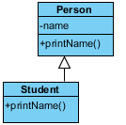
Binding
Associating the method definition with a method invocation
Two ways of binding
  Early binding (static binding)
    The association is done during the compilation based on the code written
    Type of variable referencing to a calling object determines what methods to use
  Late binding (dynamic binding)
    The association is done during the runtime when the method is actually invoked
Student s = new Student();
s.printName();
Compiler is able to resolve the method call at compile time
Compiler is not able to decide at compile time which printName() method to call.
It is resolved at runtime.
Person p;
....
p.printName();
(c) Barnes & Kolling

Slide 54
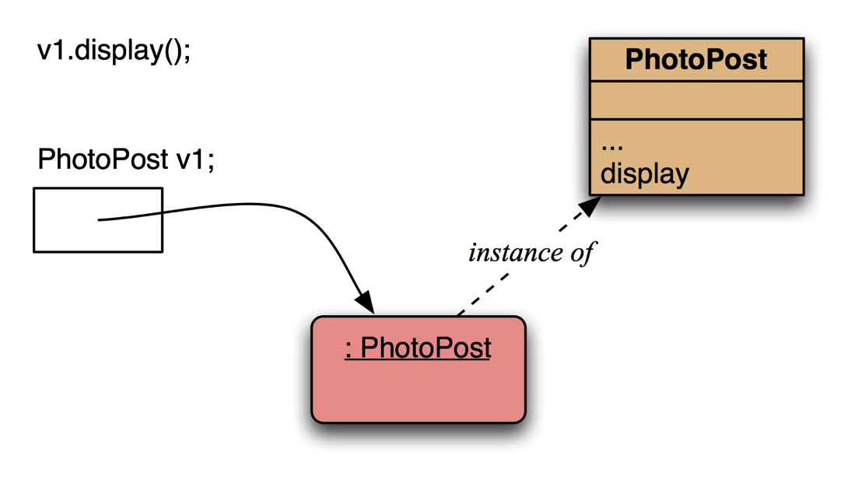
Method lookup: simple
No inheritance or polymorphism.
The obvious method is selected.
(c) Barnes & Kolling

Slide 55
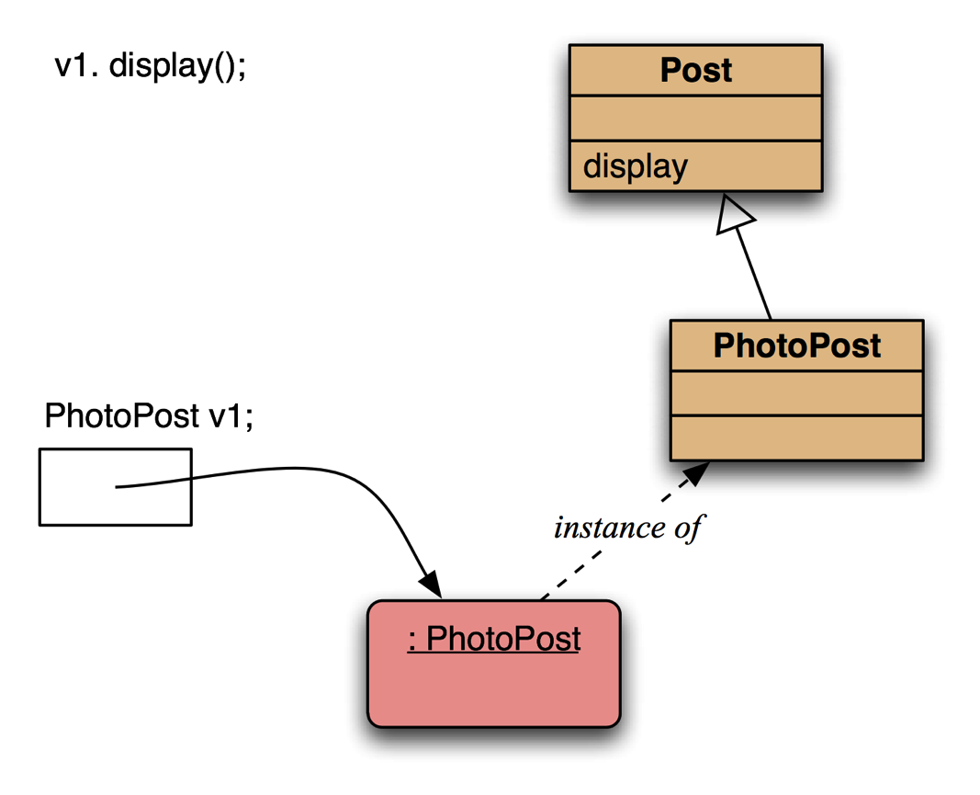
Method lookup: with inheritance
Inheritance but no overriding. The inheritance hierarchy is ascended, searching for a match.
(c) Barnes & Kolling

Slide 56
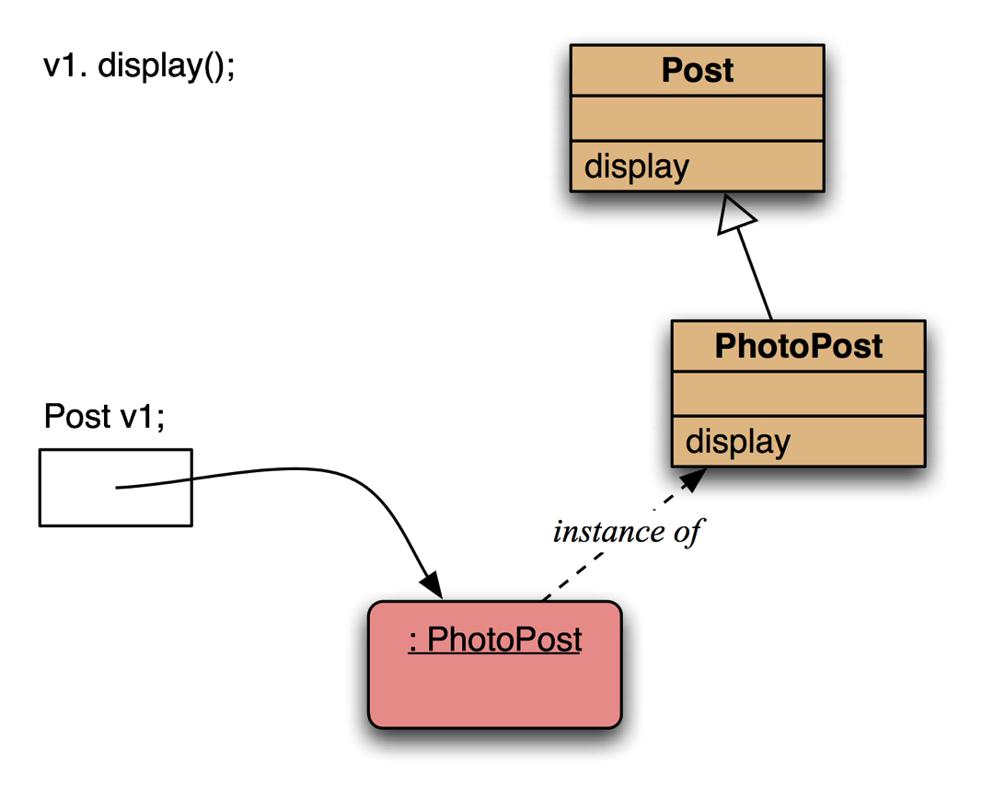
Method lookup: overriding
Declared type of v1 is Post
Polymorphism and overriding. The ‘first’ version found is used.
Overriding methods take precedence.
(c) Barnes & Kolling

Slide 57
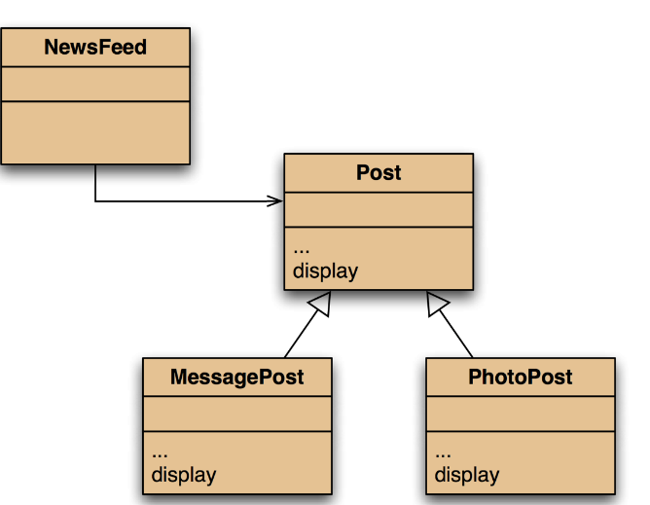
Super call in methods
Overridden methods are hidden .... but we often still want to be able to call them.
An overridden method can be called from the method that overrides it.
To call a super class method:
  super.methodname(...)
Unlike calling super() in constructors you can call the super method anywhere within the subclass method
Unlike super calls in constructors, no automatic super call is generated and no super call is required; it is entirely optional
(c) Barnes & Kolling

Slide 58

Calling an overridden method
public class PhotoPost
{ ...
...
public void display()
{
super.display();
System.out.println(" [" + filename + "]");
System.out.println(" " + caption);
}
}
Need not be first always
This is just to demonstrate how inheritance and polymorphism works, ideally printing must be done in the UI
Alexander Graham Bell
12 minutes ago - 4 people like this.
No comments.
[experiment.jpg]
I think I might call this thing 'telephone'.
from Post
from PhotoPost
Almost what we wanted
(c) Barnes & Kolling

Slide 59
Alternative solution
public class PhotoPost
{ ...
public void display()
{
System.out.println(getUserName());
System.out.println(" [" + filename + "]");
System.out.println(" " + caption);
System.out.println(getFooter());
}
}
What we wanted ☺
public class Post
{ ...
protected String getUserName()
{
return username;
}
protected String getFooter()
{
String result = timeString(timestamp);
if (likes > 0) { ...
return result;
}
...
______________________________________
protected String username;
Alexander Graham Bell
[experiment.jpg]
I think I might call this thing 'telephone'.
12 minutes ago - 4 people like this.
No comments.
New accessor methods available to subclasses
Less desirable alternative to adding getUserName()

Slide 60
Protected access level modifier
Private access (visibility) in the superclass may be too restrictive for a subclass.
The closer inheritance relationship is supported by protected access.
Protected access is more restricted than public access.
We still recommend keeping fields private.
  You may define protected accessors and mutators for use by subclasses.
(c) Barnes & Kolling

Slide 61
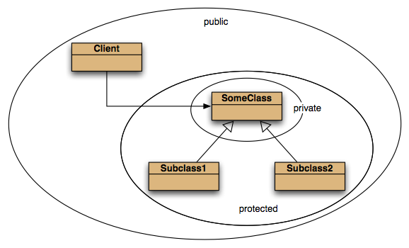
Access levels
(c) Barnes & Kolling

Slide 62
Methods of class Object can be overridden
Methods in Object are inherited by all classes.
Most commonly:
  public String toString()
  Returns a string representation of the object.
  Object’s toString returns classname@memory_address
  public boolean equals(Object other)
  Object’s equals returns this == other
    only true if this and other are referring to the same object (reference equality)
  Ideally, this method is not to check whether two objects refer to the same memory address
    It is to check whether two objects are equal in terms of instance variables within them
© Barnes & Kolling © Swinbunne

Slide 63
Overriding toString() in Post
Public class Post
{
...
  public String toString()
  {
  String text = username + "\n" + timeString(timestamp);
  if(likes > 0) {
  text += " - " + likes + " people like this.\n";
  }
  else {
  text += "\n";
  }
  if(comments.isEmpty()) {
  text + " No comments.\n";
  }
  else {
  text + " " + comments.size() +
  " comment(s). Click here to view.\n";
  }
  return text;
  }
  public void display()
  {
  System.out.println(toString());
  }
}
toString() in object class overridden
We can define the Post’s display method in terms of a call to its toString() method
(c) Barnes & Kolling

Slide 64
Overriding toString() in Post
Using StringBuilder class
public String toString()
{
StringBuilder builder = new StringBuilder();
builder.append(username);
builder.append("\n");
builder.append(timeString(timestamp);
if(likes > 0) {
builder.append(" - ");
builder.append(likes);
builder.append(" people like this.");
}
builder.append("\n");
...
return builder.toString();
}
StringBuilder objects are like String objects, except that they can be modified.
(c) Barnes & Kolling

Slide 65
Overriding equals()
Example: Student class
Public class Student
{
  public boolean equals(Object obj)
  {
  boolean result = false;
    if(this == obj) {
    result = true;
    }
    else if(obj instanceof Student) {
      // Gain access to the other student’s fields.
      Student other = (Student) obj;
      result = name.equals(other.name) && id.equals(other.id) && credits == other.credits;
    }
    return result;
  }
}
Reference equality
Making sure that it is comparing two Student objects
Comparing the fields of the Student object to ensure the fields are also same
(c) Barnes & Kolling

Slide 66
Technical note
In the prev. example:
  The operator instanceof will give true if obj is an instance of a subclass of Student class.
  If you want exactly the same class:
equals() is very important for the operation of the collection classes
  Used in contains() for all collections, add() for Set and Map
if(obj.getClass() == this.getClass())
getClass() is inherited from Object class
(c) Swinburne

Slide 67
NewsFeed Example
public class Post
{
public boolean equals(Object obj)
{
boolean result = false
if(this == obj)
result = true;
else if(obj.getClass() == this.getClass())
{
Post other = (Post) obj;
result = author.equals(other.author) &&
timestamp == other.timestamp;
}
return result;
}
(c) Barnes & Kolling

Slide 68
Method Overloading
When a class has two or more methods with the same method name but number of parameters or types of parameters are different, it is called method overloading.
Also known as static polymorphism
  Because binding of method call to its definition happens at compile time.
Unlike overloading, for overriding method signatures should be the same.
  technically Java considers name, number of parameters, all parameter types ONLY (It ignores parameter names, return type and visibility.)
public int add(int a, int b){…}
public int add(int a, int b, int c){…}
public double add(double a, double b){…}
add(4, 6);
add(0.1, 0.2);
(c) Barnes & Kolling

Slide 69
Exercises & reading
Reading:
  Barnes & Kolling Chapter 9
(c) Barnes & Kolling

